Slide 1

Judgments of Learning Improve Memory through Enhanced Item-Specific Encoding
Nicholas P. Maxwell, PhD

Slide 2

Metamemory and Learning
Metamemory: Knowledge and awareness of our own memory processes
“I’m good at remembering faces but not names.”
“I have a good memory for numbers.”
How likely are you to remember something just learned?
Provides insight about the learning process!
Notes:
Satisfies Learning Objective 1: Learn the four principles of memory improvement and learning efficiency.
Retrieval practice:
Generate and practice the items you need to remember from memory rather than simply read or restudy them.
Retrieval practice means self-testing.
Metamemory: Our knowledge and awareness of our own memory processes.
Distributed learning or practice: Spacing one’s study over time can lead to faster acquisition of information.

Slide 3
Judgments of Learning (JOLs)
How likely are you to remember the target if shown only the cue?
Cue
Target
Mouse - Cheese

Slide 4
Judgments of Learning (JOLs)
How likely are you to remember the target if shown only the cue?
Cue
Target
Mouse - ?
Judgements of Learning (JOLs) are often made on a 0 – 100 probability scale

Slide 5
JOL Reactivity
JOL Reactivity: The act of making JOLs at study changes how studied information is processed
Positive reactivity: Memory Benefits
Negative reactivity: Memory Costs
Notes:
Reactivity doesn’t necessarily imply a memory improvement

Slide 6


Item-Specific/Relational Encoding
Encoding tasks differ in the likelihood that they encourage processing of unique or related features of study pairs
Item-Specific – Cats have fur but turtles have shells, cats are mammals but turtles are reptiles, etc.
Relational – Both are living creatures, both kept as pets, etc.

Slide 7
The Present Study
Item-order account of Reactivity: Making JOLs individually for words in a simultaneously disrupts relational encoding but enhances item-specific
The present study tests this account using two JOL types which differentially promote item-specific and relational encoding
Item-level JOLs: Made individually for each word in a study list
Global JOLs: Holistic judgments for each list
Experiment 1: Related vs. Unrelated lists
Experiment 2: DRM lists
Hypotheses:
Item-level JOLs will improve recognition memory compared to silent reading
Global JOLs will be non-reactive on recognition

Slide 8
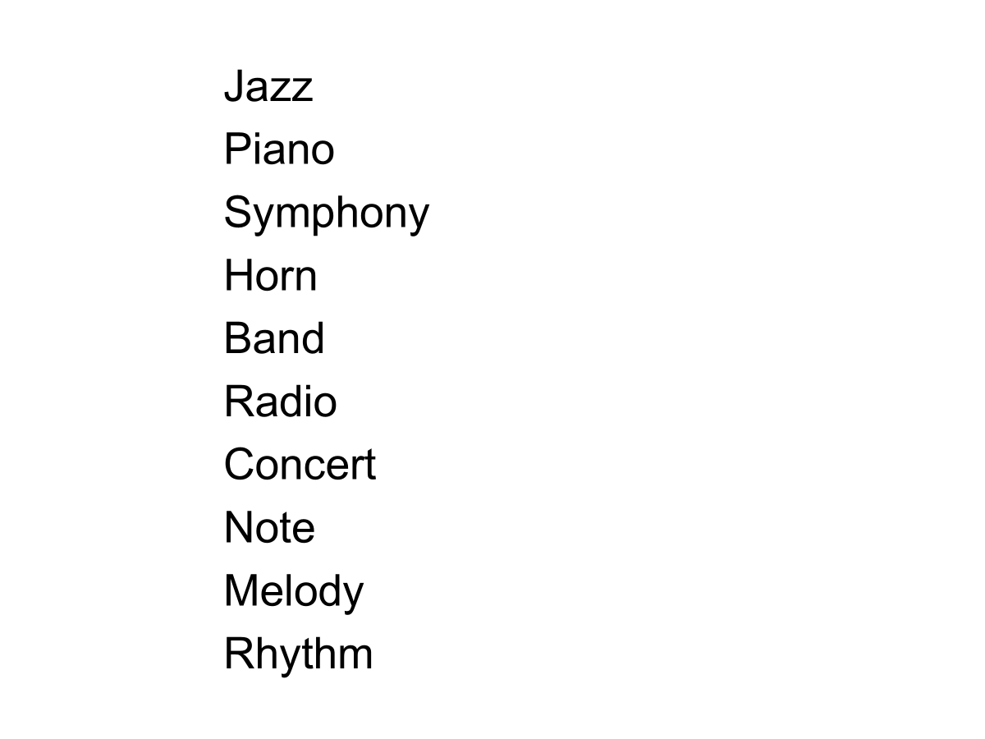
DRM List Example
Notes:
Satisfies Learning Objective 3: Illustrate the measures that have been used to examine false memory, namely the Deese–Roediger–McDermott procedure, and the false-memory induction procedure.
Critical intrusion: The false memory created by a list in which all of the words are related or associated with the absent but suggested word.
Deese–Roediger–McDermott (DRM) procedure:
Used to induce false memories for items on word lists.
Associates to an unpresented word are given, and the unpresented word is often recalled.
Devised by Roediger and McDermott.
Effectiveness and flexibility of method:
Illustrated by Knott and Shah through an experimental study to determine the role of emotions in the production of false memories.
They concluded that DRM can be used to examine memory in emotional contexts.

Slide 9
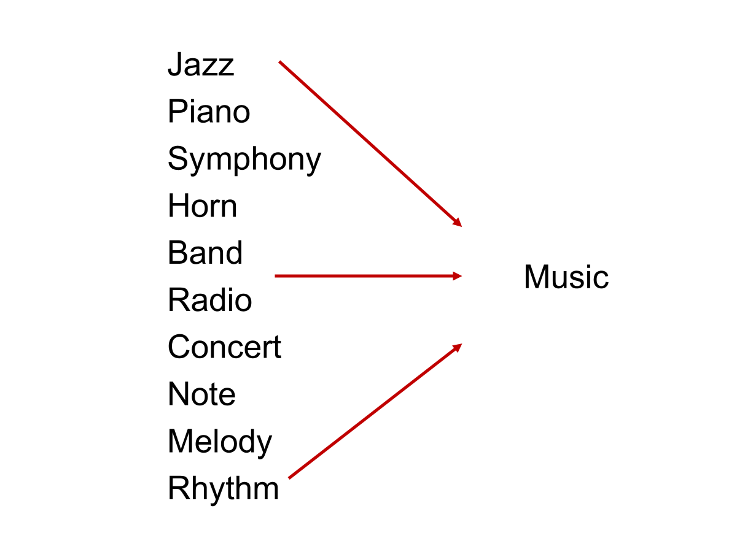
DRM List Example
Critical Lure (CL)
(Not Presented)

Slide 10
JOL Types
Item-level: Made individually after studying each word in the list
e.g., Jazz: How likely will you remember this word an upcoming memory test?
Global: Made following the final word in the list
e.g., How likely will you remember the words you just studied on an upcoming memory test?
Item-level JOLs: emphasize item-specific encoding
Global JOLs: emphasize relational encoding

Slide 11
General Method
Participants
Experiment 1: 119 MSU undergrads
Experiment 2: 112 MSU undergrads
All participants randomly assigned to make item-specific JOLs, global JOLs, or silently read study lists
Material:
Experiment 1: Four 12-word study lists (2 categorized; 2 uncategorized)
Experiment 2: Ten 12-word DRM lists
OLD/NEW recognition tests
General Procedure (all experiments):
Study → Filler → Test (~20 minutes)

Slide 12
Experiment 1 Results

Slide 13
Experiment 2 Results

Slide 14
Summary
Item-level JOLs improved recognition of all studied words, regardless of list type
Global JOLs were non-reactive on correct recognition
However, global JOLs increased false recognition of DRM lures
Findings support an item-specific account of reactivity
Only the JOL task that emphasized each unique word improved memory!

Slide 15
Future Directions
Recall vs. Recognition tests
Previous work suggests that JOL reactivity effects may be tied to test format (Myer, Rhodes, & Housman, 2020)
Explore the specific memory cues that item-specific encoding strengthens
Recollection vs. Familiarity (R/K paradigm; Tulving, 1985; 1989)
Explore JOL reactivity with educationally relevant study materials (Maxwell & Adkins, under review)

Slide 16
Thank you!
Questions?

